Slide 1
Predictable Purchases by Jordan Deagan
On predicting the purchase of certain items based on when and what was purchased

Slide 2

The Question
Based on data from previous purchases from a variety of shoppers, can a predictive algorithm correctly guess when someone will purchase a given item?

Slide 3
The Data
I used information from Instacart about orders made by users on Instacart, as well as product and aisle information to provide reference to the data.
There was information on the store’s products, user orders, and products in orders.

Slide 4
My Approach
Using the data sets provided by Instacart, I created a Decision Tree with ID3 and a Markov Chain to predict if a user will buy a product next, splitting the data into training and testing data.

Slide 5
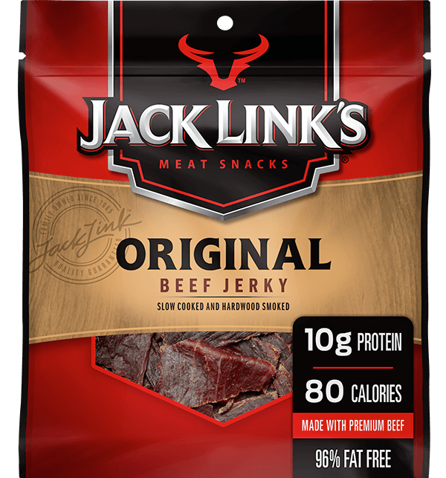
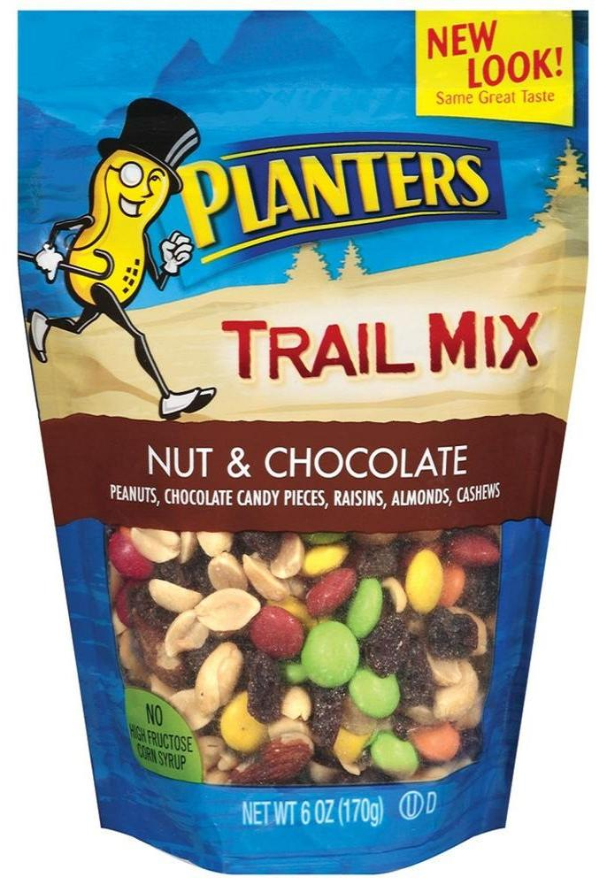
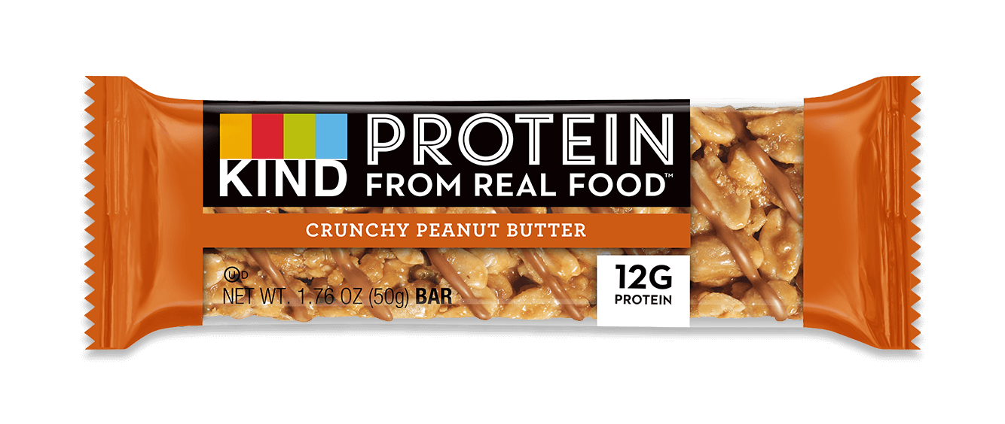
Sample Products

Slide 6
Why?
I want to see if I can develop a classifier based on chaotic data such as grocery purchases
I am curious about human behavior and I like food.

Slide 7
Preprocess
I created a list of product IDs for each product type
I turned the lists of ordered products into a dictionary keyed by order ID
I reorganized the training and testing data, as well as adding a feature for containing a product.

Slide 8
The Process
I altered the ID3 from project 3 to work on my new data, then trained the tree on a unedited list for each product as well as a list of orders by users who have bought the product at least once.
I created transition rates for each of the lists above to be used in my Markov Chain, then tested all of the weights on the training and testing data 10 times to see their averaged accuracy.

Slide 9
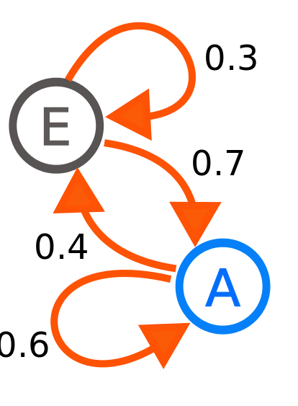
Markov Chains
A Markov Chain is a state-based probability model. It looks at the current state, and based on transition rates for that state, it creates the probability of what state the next iteration will be.

Slide 10
The results
I ended up with 6 Decision Trees, and 6 Markov Chains. I tested both on the training and testing data, with 10 tests run for each Chain to average the probabilities.

Slide 11
The results(ID3)
Nothing Happens. 99% accuracy
There was not enough features to split on, the features available were all very wide, and there was undersampling in both versions of the training, less so in the second set, but still present. This resulted in most of the branches being negative, and those with positive results were probabilities with a less than 10 chance at buying the product.

Slide 12
The results(Markov Chain)
Mostly Accurate, if for similar reasons
The transition rates from an order with a product never changed between the two sets of a product, but in the user based set, it was more likely that an order without a product will transition to an order with a product, causing a decrease in accuracy.

Slide 13
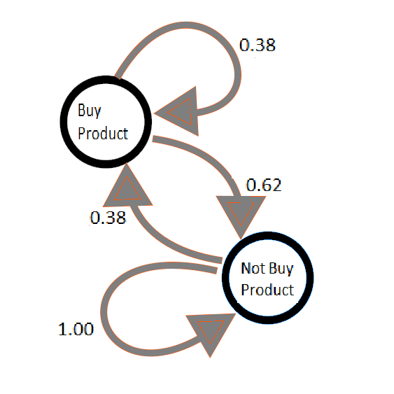
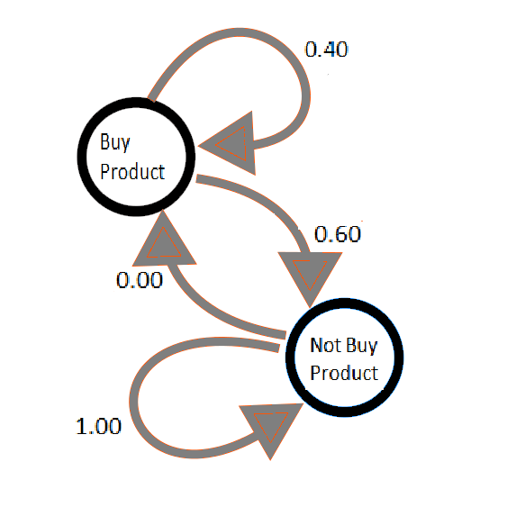

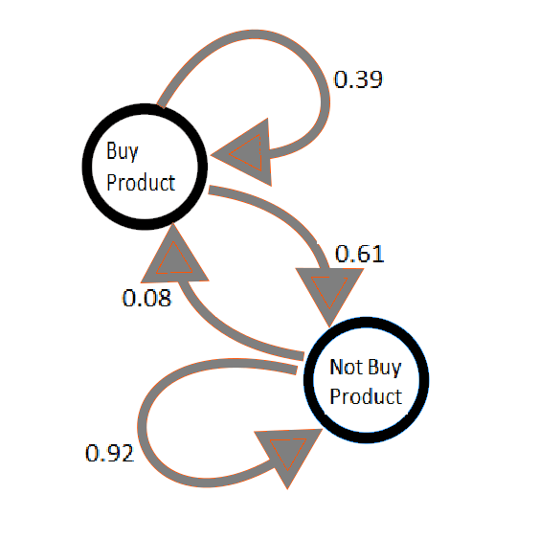


Trail Mix
Beef Jerky
Protein Bars

Slide 14
Conclusion
With limited data, like I had, Decision Trees are not ideally suited to finding rules. Probability models work better, but can still be a tad imprecise. A model probably can be created, given time and the right algorithm, but not given my timeframe and current skill level.

Slide 15
Future Work
Using different probability models to find which one has higher accuracy and precision
Look into a wider variety of products when creating a model.

Slide 16
Potential Uses
Predicting how much of a product to purchase
Targeted promotions
Be used to identify differences in behaviors.

